Slide 1

US Accident Traffic Analysis
and Severity Predictive Model
Big data Project
Team:
1. Aditya Ashtekar: ama1219@nyu.edu
2. Ishan Tickoo: it732@nyu.edu
3. Meghana Bachu Srinath: mbs674@nyu.edu

Slide 2
Problem Statement
Approximately 6 million car accidents occur in the US every year. These accidents cause traffic delays that result in unprecedented waste of fuel and pollution, and even halt emergency services. All this leads to loss of valuable resources and time.

Slide 3
Objective
Accurate prediction of severity of accidents can mitigate a considerable amount of road accidents and help saving time. Most of the analysis and prediction use a small dataset which leads to inaccuracies or more false positives. Here for analysis we have used a dataset that consists of around 2.4 million entries spread across the entire US. A prediction model using Random Forest Classifier is also built for the entire dataset to predict the severity of an accident.
We can apply this model in realtime and use is to notify the travellers about the calculated severity so that they can switch alternative routes and also the authorities so that they can gather the resources needed to mitigate the delay.

Slide 4
Dataset Used
US-Accidents: A Countrywide Traffic Accident Dataset from Kaggle[1][2]
2.9 million (approx) Accidents from 2016-2019
Each accident is described with 49 different attributes.

Slide 5

Tech Stack

Slide 6
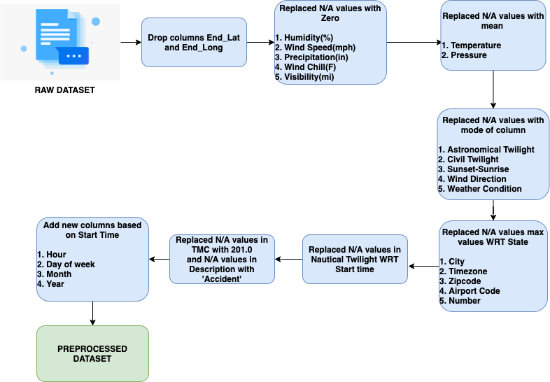
Data Preprocessing

Slide 7
Data Analysis
After data preprocessing, data analysis is done to generate insights about the dataset.
Graphs are plotted using Tableau for better visualization.
Some of the graphs are displayed in the following slides.

Slide 8
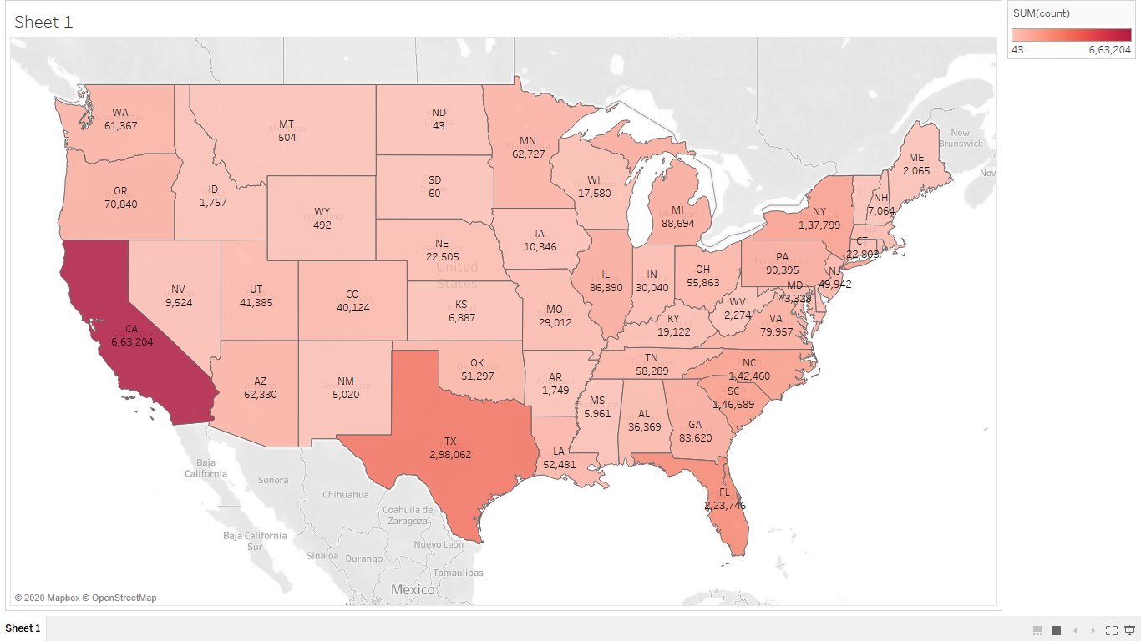
Accidents in different states of US

Slide 9
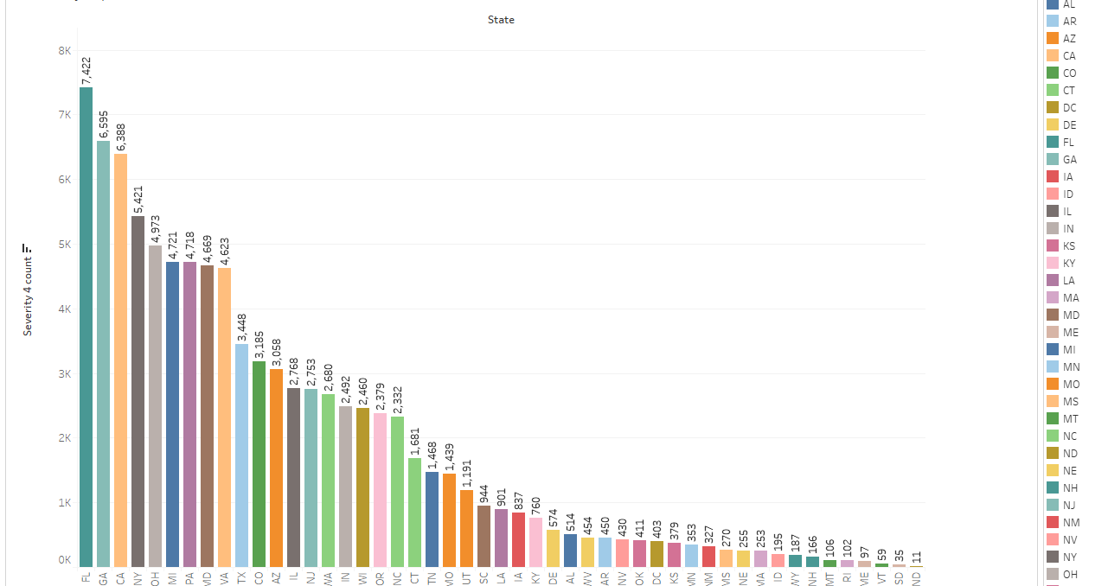
Severity 4 count of each state

Slide 10
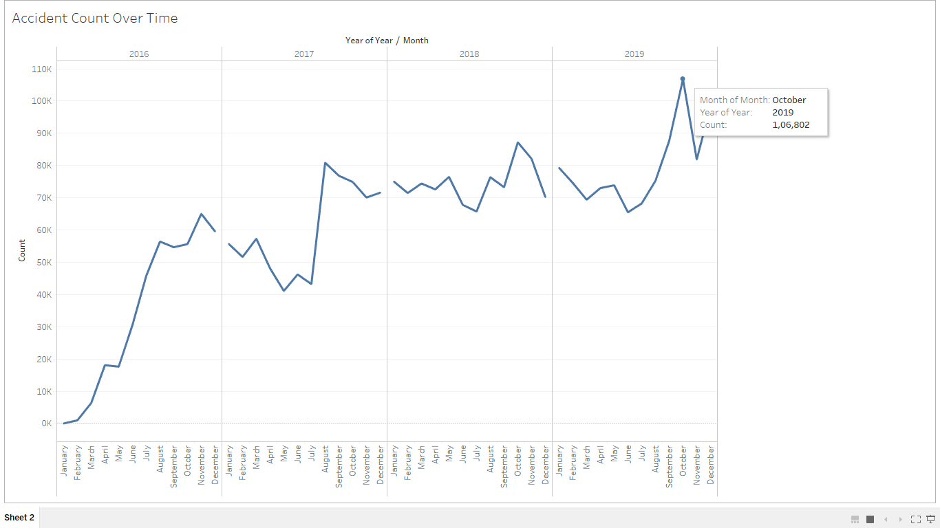
Accidents count over the span of three years

Slide 11
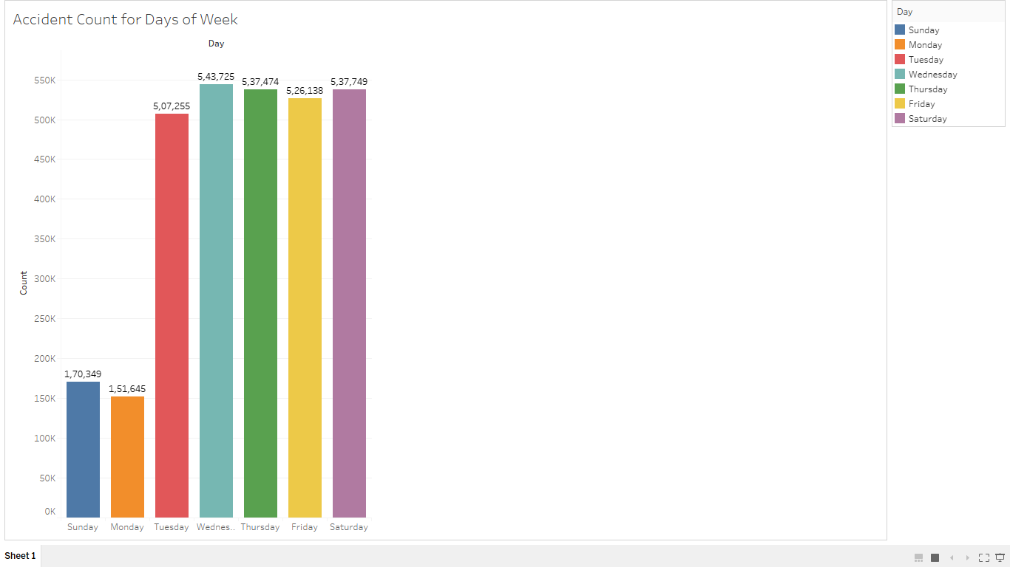
Accidents count for different days of the week

Slide 12
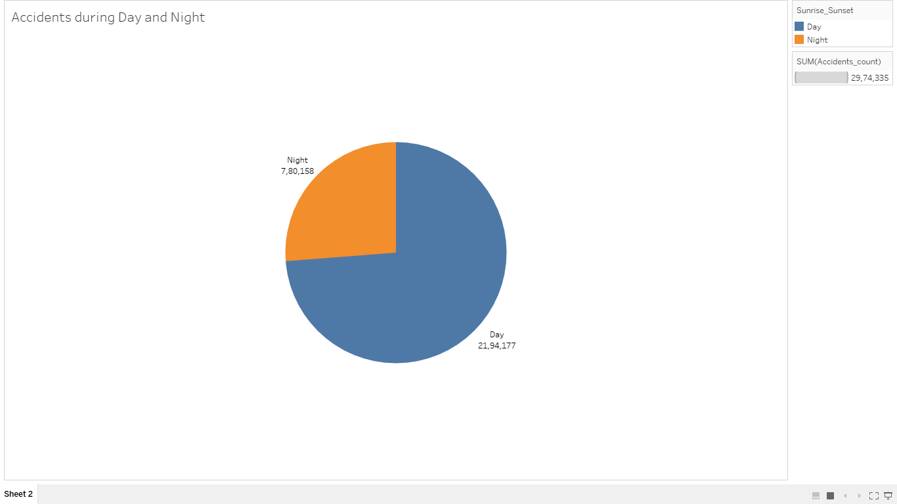
Accidents distribution between day and night

Slide 13
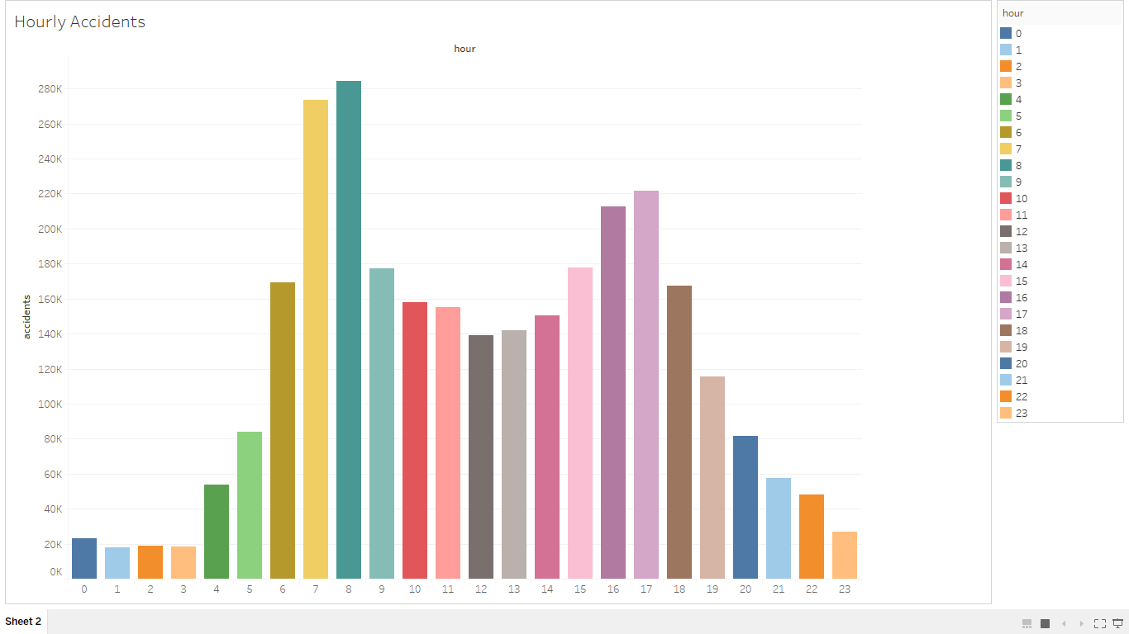
Accident count by the hour

Slide 14
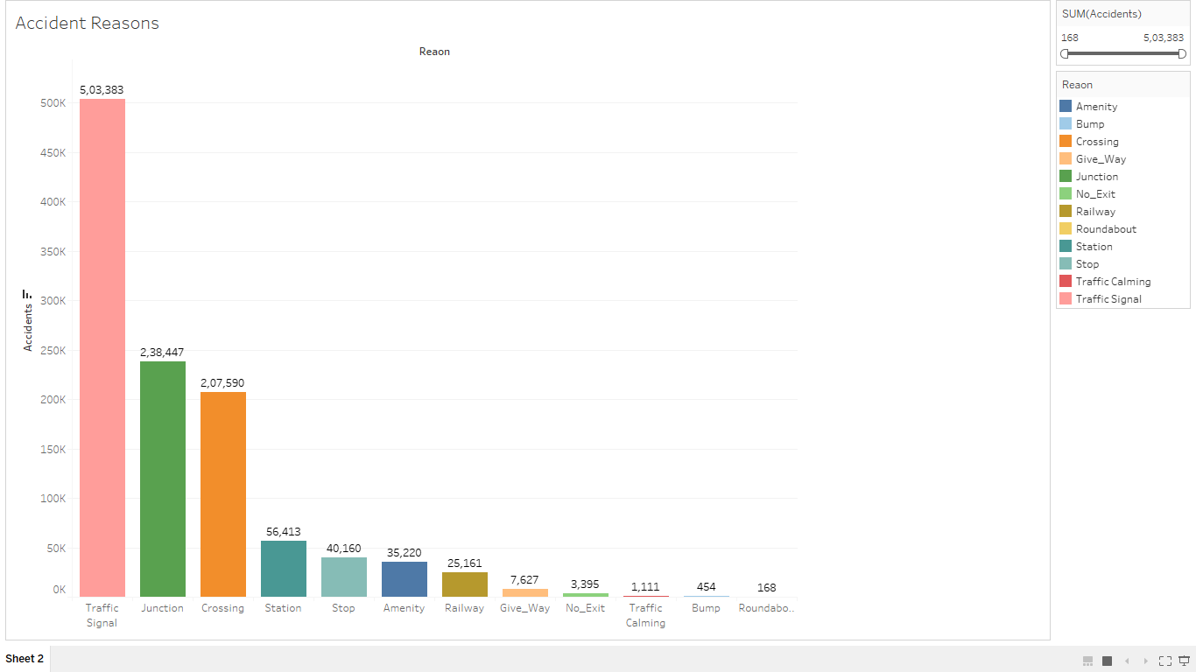
External factors that act in accidents

Slide 15
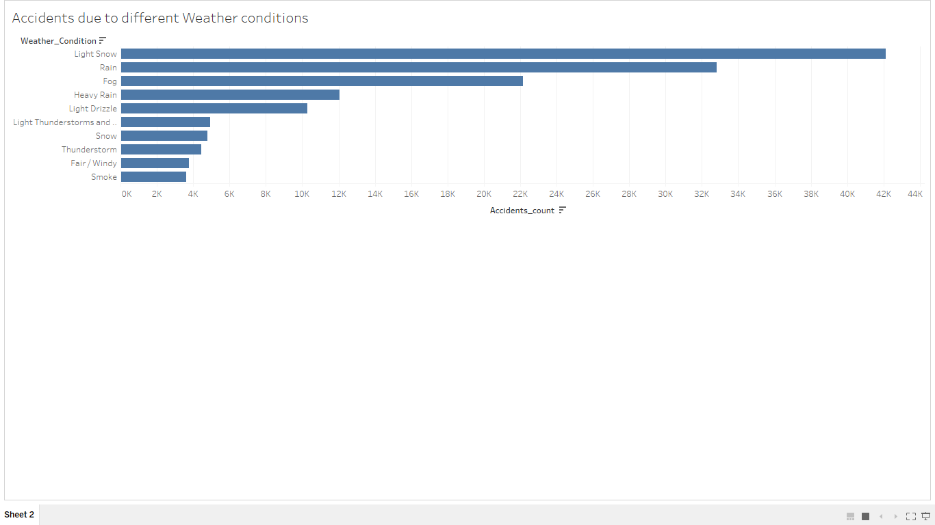
Accidents due to different weather conditions

Slide 16
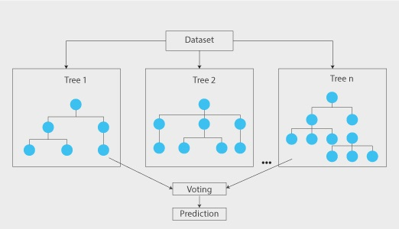
Prediction Model
Random Forest

Slide 17
Model Description
Features used: 31
Trees:12
Max depth of each tree: 16
Train, Test data split: 70:30
Feature Importance:
State: 17%
Side: 16%
Traffic Signal: 12%
Source: 12%
Distance: 8%
Accuracy: 75%

Slide 18
Conclusion and Future Work
Traffic accidents cause a lot of chaos. It not only causes trouble only to the people who are involved in the accident, it also affects people who are struck in traffic. Most of the accident analysis is done on a smaller data set which is often not very reliable. Hence we have used a dataset which has over 2 million entries. A Prediction model to predict severity is also built.
With the help of the given prediction model we can build an application, similar to maps which also informs the user about the possible severity and the time delay that may be caused if an accident occurs in their route.

Slide 19
References
Moosavi, Sobhan, Mohammad Hossein Samavatian, Srinivasan Parthasarathy, and Rajiv Ramnath. “A Countrywide Traffic Accident Dataset.”, arXiv preprint arXiv:1906.05409 (2019).
Moosavi, Sobhan, Mohammad Hossein Samavatian, Srinivasan Parthasarathy, Radu Teodorescu, and Rajiv Ramnath. “Accident Risk Prediction based on Heterogeneous Sparse Data: New Dataset and Insights.” In proceedings of the 27th ACM SIGSPATIAL International Conference on Advances in Geographic Information Systems, ACM, 2019.

Slide 20
Any Questions?

